Slide 1



Project
entitled
CYCLONE PREDICTION BASED ON SATELLITE DATA USING DEEP LEARNING
Presented by:
Sanjit Anand (U19EC008)
Siddharth Gautam (U19EC023)
Somya Gupta (U19EC032)
Internal Guide:
Dr. Prashant K. Shah
Associate Professor, DECE
Examiners:
Dr. Anand D Darji
Associate Professor, DECE
Dr. Deepak Joshi
Assistant Professor, DECE
Dr. Abhishek Acharya
Assistant Professor, DECE
Dr. Nithin Chatterji
Assistant Professor, DECE
Group-22

Slide 2
Outlines
Introduction
Objectives
Motivation
Literature Survey
Theoretical Background
Cyclone Prediction - Methodology and Workflow
Cyclone Prediction - Results
Path Forecasting – Methodology and Workflow
Path Forecasting - Results
Conclusion
Future Work
Our Contribution
References
Appendix - Dataset

Slide 3
Introduction
India, possess a large coastline of 7516.6 km is highly prone to cyclones.
Cyclone prediction is a crucial aspect of meteorology and natural disaster management.
Deep learning algorithms can be used to analyze and interpret a large amount of data from various sources, such as weather satellite imagery, atmospheric pressure readings, and wind patterns, to predict the likelihood and severity of a cyclone.
Pg. 1

Slide 4
Objectives
Our core objectives are:
Deep Learning model for detection of cyclone in its early stage of formation accurately
Predicting the direction and the path of the movement of the cyclones so as to alert the cyclone prone areas in advance.
To test the accuracy of latest object detection and time series forecasting methods.
Pg. 2

Slide 5
Motivation
Cyclones are natural disasters that can have devastating impacts on communities, causing loss of life, damage to property, and disruption to essential services.
Around 10,000 people are killed on average each year due to cyclones. Gaja cyclone of 2018 killed 300 people and over 2500 buildings were destroyed.
Accurate and reliable predictions of cyclone formation and development are therefore critical for helping people in affected areas to evacuate. Satellite data can provide valuable information about cyclones, such as their size, shape, and intensity.
Pg. 3

Slide 6
Literature Review
Md. Nazmul Haque et al [1] used two stage process to detect cyclone. In first step they detected the cyclone using various models like CNN , SVM, KNN,VGG16, RF, ANN and in second step they worked on detecting the eye of cyclone using YOLO algorithm.
Preprocessing techniques like gray scaling the image and thresholding.
Cross-validation techniques to prevent models from bias and overfitting.
87.86% mAP for cyclone detection
Shakya S. et al [2] have used the deep learning techniques for two purposes, viz. classifying an image under the category of storm or no storm and predicting the storm location in the near future.
97% accuracy for storm no storm classification – CNN architecture.
84% confidence for detecting the cyclone – YOLO with R-CNN
Pg. 4

Slide 7
Literature Review
Selim Furkan Tekin et al. [3] studied tropical cyclone trajectories using deep learning techniques.
RNN-baed deep learning architecture called TrajGRU to capture complex temporal patterns and perform forecasts. The performance was analysed in terms of kilometers at various hourly resolutions.
Used IBTrACS Dataset for predicting hurricane trajectories. This model also used atmospheric feature images at different pressure levels.
Yanfei Zhang et al. [4] used matrix neutral networks for cyclone track prediction for South Indian Ocean.
Employed prominent RNN architectures as baseline models which includes Elman RNNs, Long Short-Term Memory and Gated Recurrent Unit Networks.
Proposed use of MNNs to predict the future location of a cyclone based on its current position and various atmospheric variables such as temperature, humidity, and wind speed.
Pg. 5

Slide 8
Theoretical Background
Object Detection:
subfield of machine learning and computer vision that involves identifying and locating objects in images or videos
Successful object detection models : R-CNN and YOLO
Applications: autonomous vehicles, surveillance systems, and image/video search engines.
R-CNN (Regional Based Convolutional Neural Network)
Uses CNN to classify and locate objects in an image
Generates a set of region proposals, which are potential locations of objects and outputs class probabilities and bounding box coordinates for each proposal
Computationally Expensive due to multiple forward and backward passes through the CNN for each image
Pg. 6

Slide 9
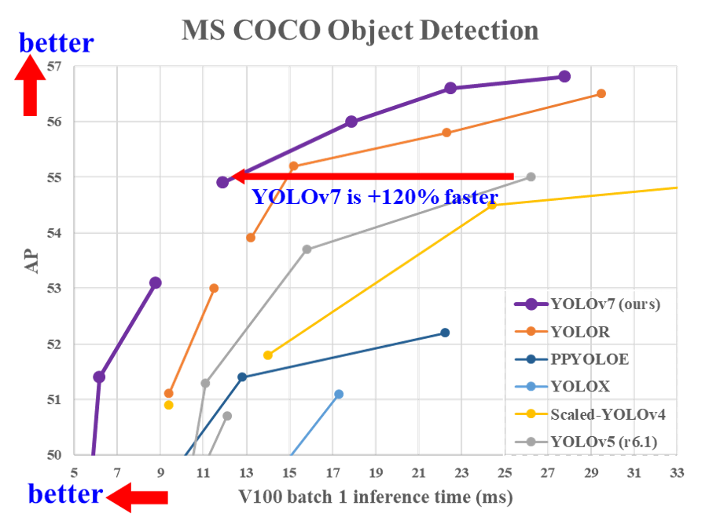
YOLO
YOLO (You Only Look Once) is a popular algorithm for object detection in images and videos.
Developed by Joseph Redmon and Ali Farhadi in 2015.
Fig.1 shows that YOLOv7 is much faster than other object detection models.
Fig:1 YOLO Speed Comparision [5]
Pg. 7

Slide 10
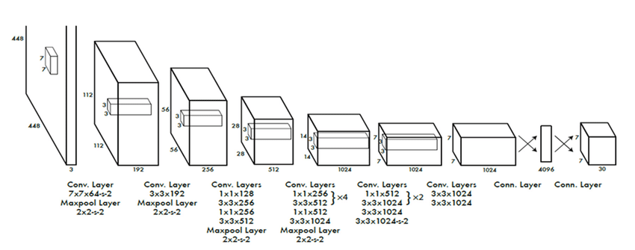
YOLO Architecture
Fig:2 YOLO Architecture [5]
Pg. 8

Slide 11







Tools and Libraries Used
Google Colaboratory
LabelImg
Kaggle
PyTorch
OpenCV
Matplotlib
OS
Keras
GeoPandas
Fig:3 Toolkit
Pg. 9

Slide 12
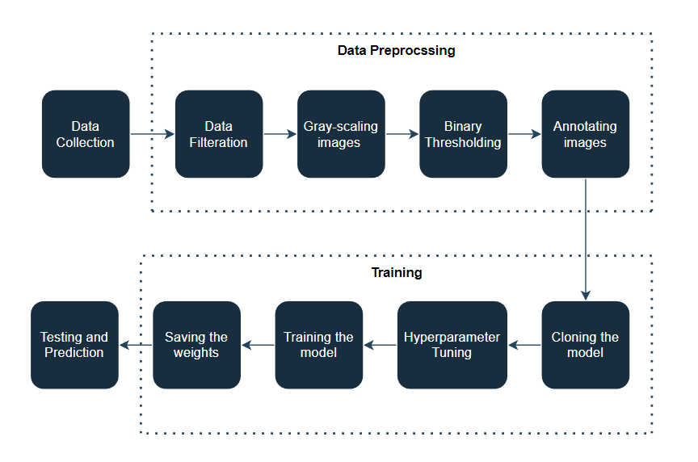
Workflow Diagram
Fig:4 Workflow
Pg. 10

Slide 13
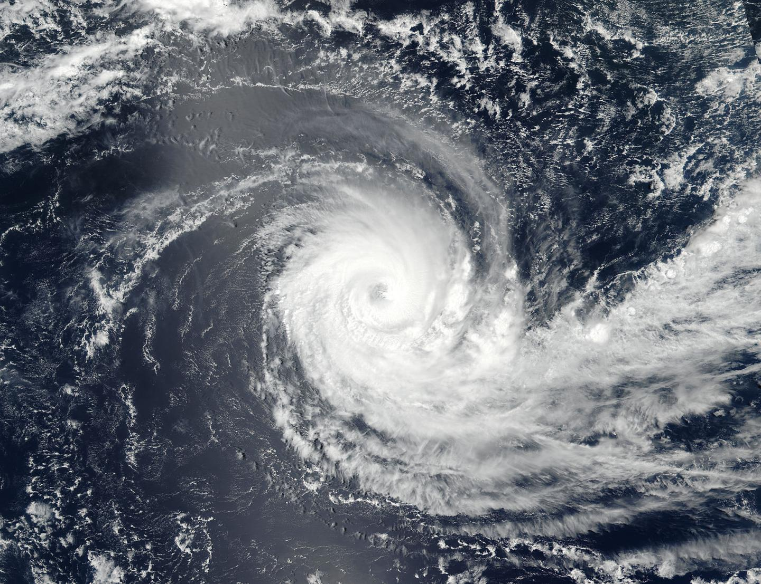
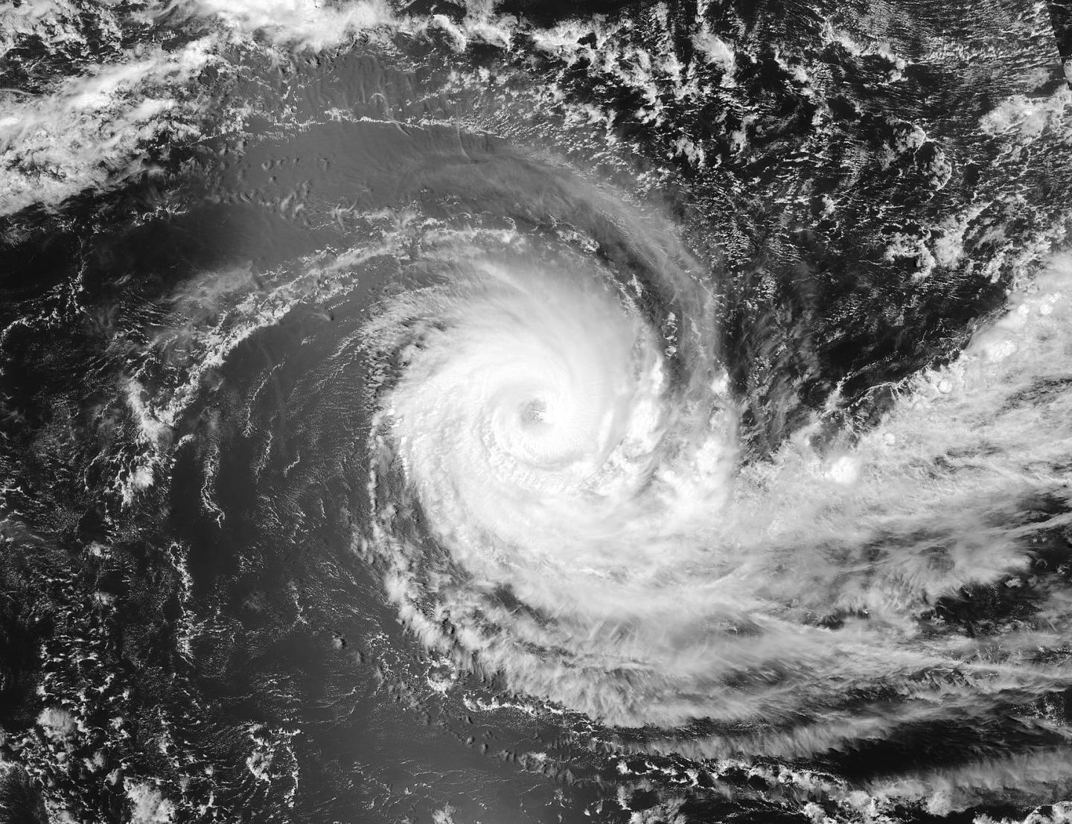
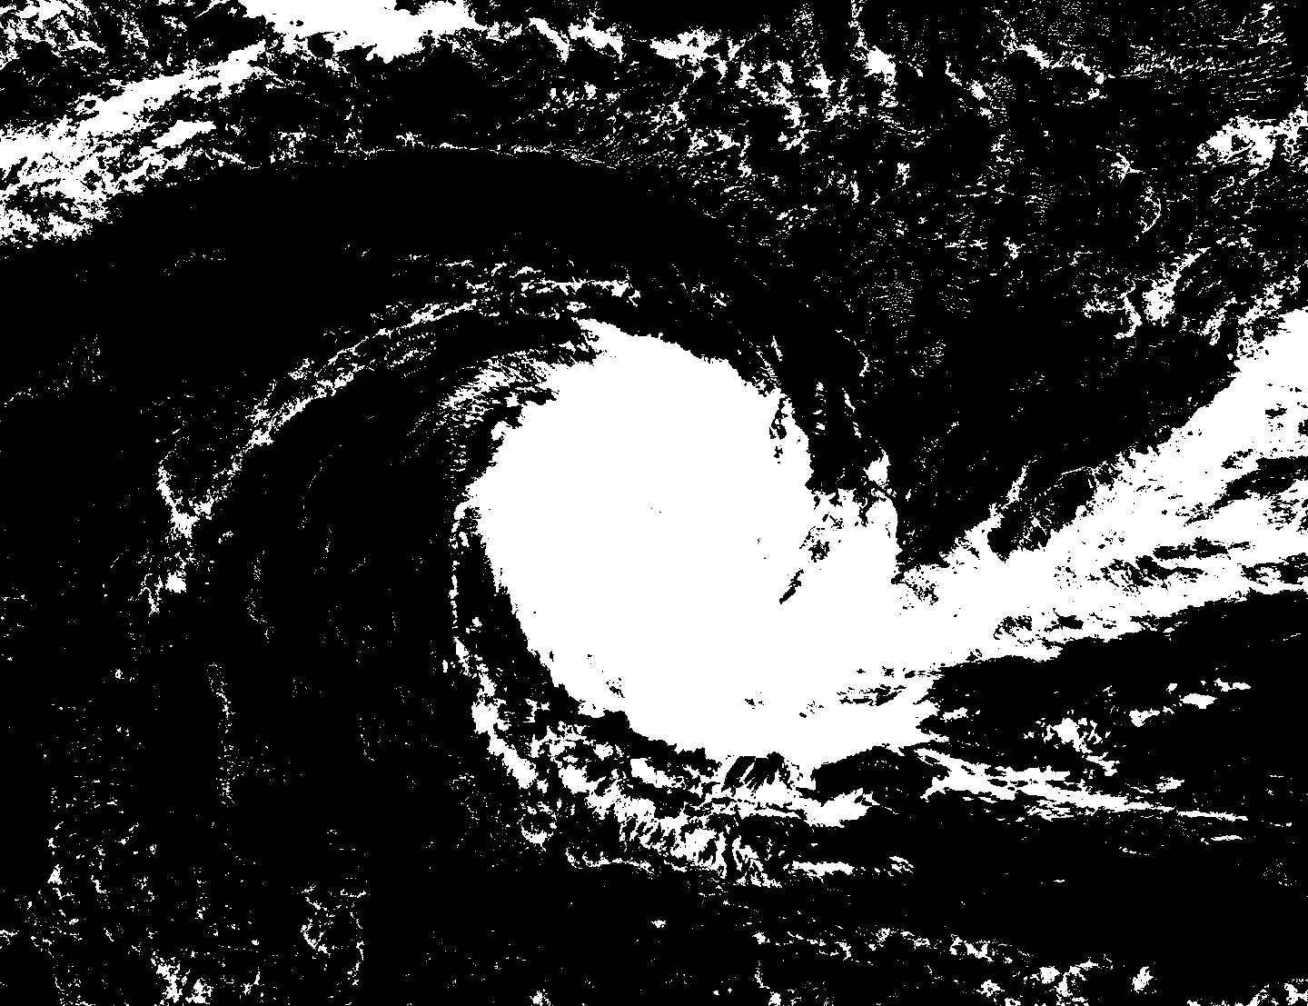
Data Preprocessing
a) Original Image
b) Grayscale Image
c) Binary Thresholding
Fig:5 Image Processing
Pg. 11

Slide 14
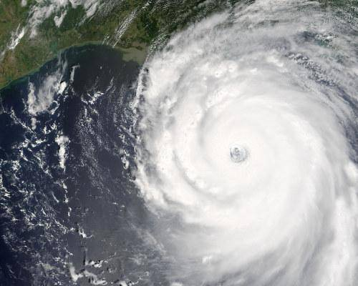
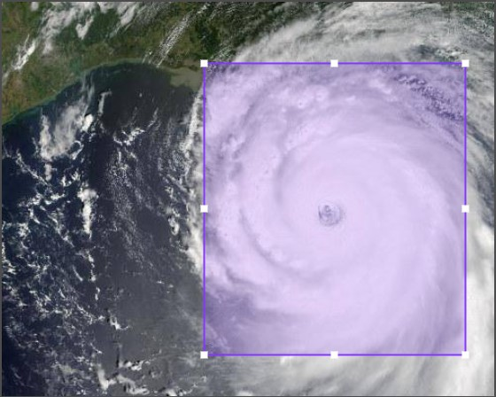
Data Annotation
a) Original Image
b) Augmented Image
Fig:6 Annotations
Pg. 12

Slide 15
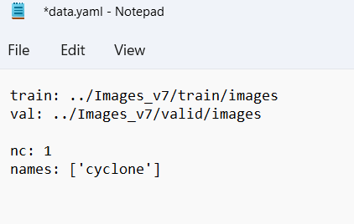
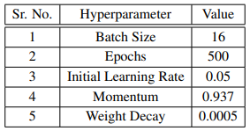
Training the model
Setting up the model
Download the original YOLOv7 model for training on our custom object
Modifying data.yaml file
Hyperparameter Tuning
Fig:7 data.yaml file
Table:1 Hyperparameters
Pg. 13

Slide 16
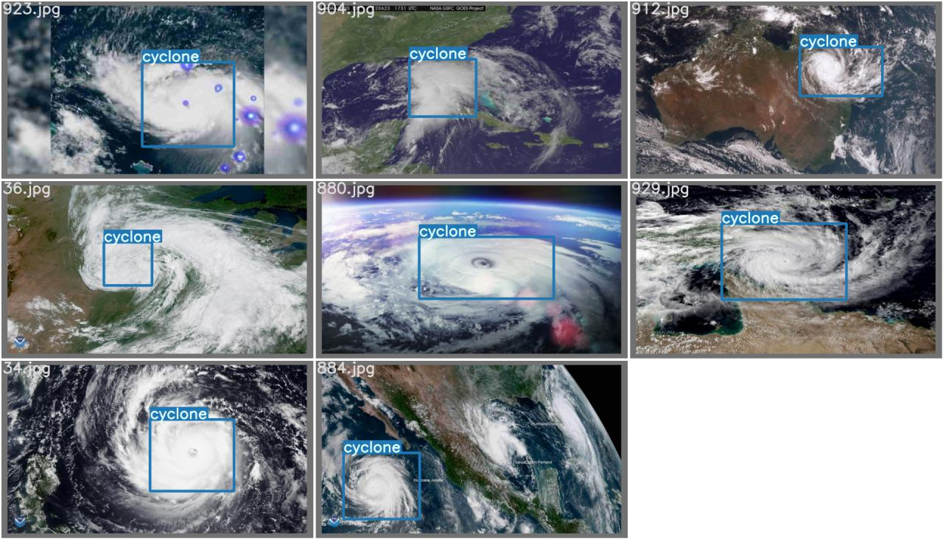
a)
b)
Fig:8 Detected Cyclone Images
Pg. 14

Slide 17
Training Results
 | True Positive | True Negative
Predicted Positive | 320 | 27
Predicted Negative | 33 | 22
Sr. No. | Metrics | Training | Testing
1 | class | cyclone | cyclone
2 | Images | 1608 | 402
3 | mAP | 0.742 | 0.68
4 | Accuracy | 0.91 | 0.85
Table:2 Confusion Matrix
Table:3 Accuracy
Pg. 15

Slide 18
Cyclone Path Prediction
Time Series Forecasting:
Using statistical models and machine learning algorithms to make predictions about future values based on historical data.
A time series is a sequence of data points collected at regular intervals over time.
Examples of time series data include stock prices, weather data, and sensor data from industrial equipment or latitudes, longitudes, and other features of a cyclone’s eye at regular intervals, which is being used in this project.
Techniques include statistical methods such as ARIMA as well as machine learning algorithms such as neural networks.
Pg. 16

Slide 19
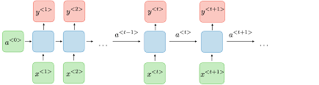
Recurrent Neural Network
A recurrent neural network (RNN) is a type of artificial neural network which uses sequential data or time series data.
RNN works on the principle of saving the output of a particular layer and feeding this back to the input in order to predict the output of the layer.
RNN have a memory which remembers all information about what has been calculated
RNN suffers from vanishing gradient problem
Fig:9 RNN architecture [8]
Pg. 17

Slide 20
Long Short-Term Memory
A traditional RNN has a single hidden state that is passed through time, which can make it difficult for the network to learn long-term dependencies.
LSTMs address this problem by introducing a memory cell, which is a container that can hold information for an extended period of time.
The memory cell is controlled by three gates: the input gate, the forget gate, and the output gate.
These gates decide what information to add to, remove from, and output from the memory cell.
Fig:10 LSTM architecture [9]
Pg. 18

Slide 21
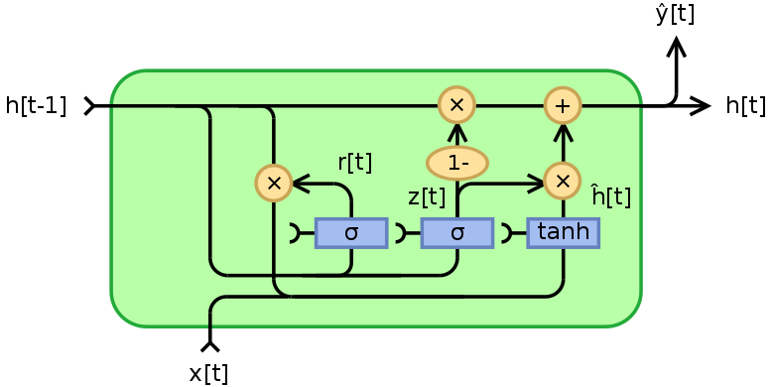
Gated-Recurrent Unit
The basic idea behind GRU is to use gating mechanisms to selectively update the hidden state of the network at each time step.
The gating mechanisms are used to control the flow of information in and out of the network.
The GRU has two gating mechanisms, called the reset gate and the update gate.
The reset gate determines how much of the previous hidden state should be forgotten, while the update gate determines how much of the new input should be used to update the hidden state.
Fig:11 GRU architecture [10]
Pg. 19

Slide 22
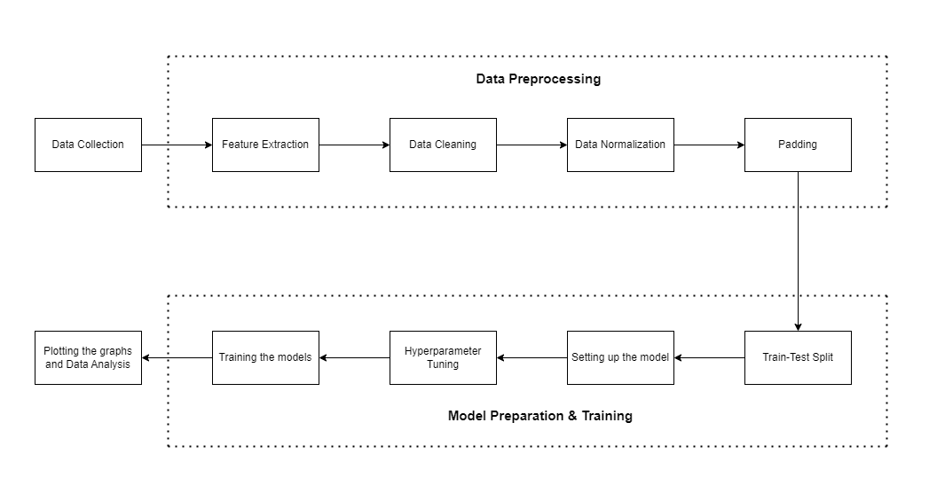
Workflow Diagram
Pg. 20

Slide 23
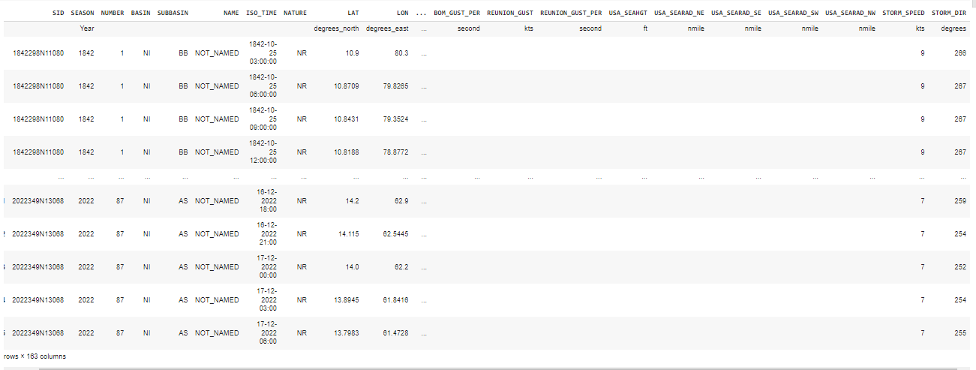
Dataset - IBTrACS
Pg. 21

Slide 24
Data Preprocessing
Feature Extraction
Dataset used for cyclone path prediction initially has lot of features that are of no use to us like time, year and nature of cyclone.
We only extracted ID, latitude , longitude, wind speed and wind direction only
Data Cleaning
Few values of latitude, longitude were in string format which was converted into float format
The rows with missing or null values were removed from the dataset
Pg. 22

Slide 25
Data Preprocessing
Data Normalization
In order to achieve better accuracy of the model we divide the latitude, longitude, wind speed and wind direction by their maximum values.
Data Padding
In order to make sure all cyclones have same number of time stamps we pad the data by taking mean of data
Cyclones having number of time stamps less than 18 and greater than 35 are ignored.
Pg. 23

Slide 26
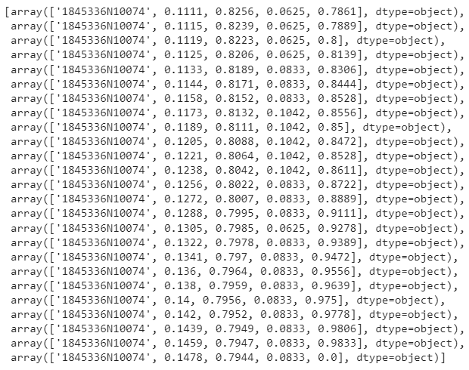
Data
Pg. 24

Slide 27
Training Model
For training data, 75% of the original dataset is used and the other 25% is used for test split.
For every cyclone 23 datapoints are used as input and 12 datapoints are predicted by the forecasting model.
Datapoints are recorded at the intervals of 3 hours.
This implies almost 3 days of data is used to predict the path of cyclone for next two days
Pg. 25

Slide 28
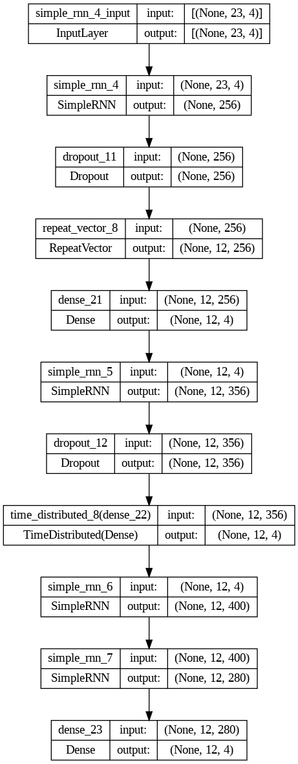
Model Description – Simple RNN
Sr. No. | Hyperparameters | Value
1 | Batch Size | 32
2 | Epochs | 500
3 | Optimizer | Adam
4 | Loss Function | Mean Square Error
5 | Activation Function | Relu
Table:4 Hyperparameters of Simple RNN
Pg. 26

Slide 29
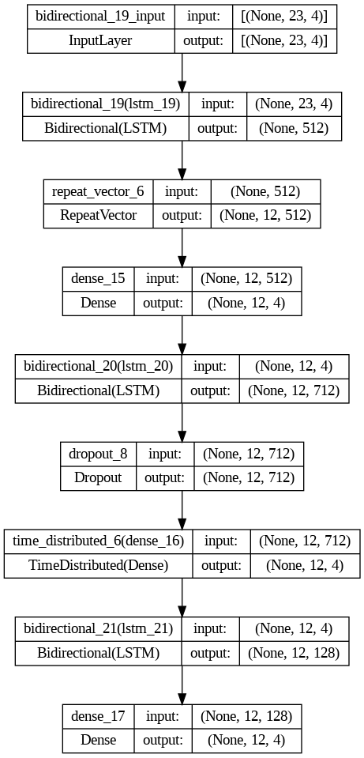
Model Description – Bi-LSTM
Sr. No. | Hyperparameters | Value
1 | Batch Size | 32
2 | Epochs | 500
3 | Optimizer | Adam
4 | Loss Function | Mean Square Error
5 | Activation Function | Tanh
Table:5 Hyperparameters of Bi-LSTM
Pg. 27

Slide 30
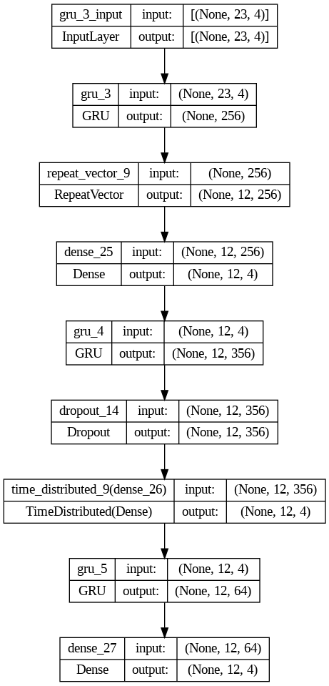
Model Description – GRU
Sr. No. | Hyperparameters | Value
1 | Batch Size | 32
2 | Epochs | 500
3 | Optimizer | Adam
4 | Loss Function | Mean Square Error
5 | Activation Function | Tanh
Table:6 Hyperparameters of GRU
Pg. 28

Slide 31
Challenges Faced
Threshold Parameter Tuning
Uneven Length of Cyclone Data
Batch size and Memory Limit
Hyperparameter Tuning
Problem of Overfitting
Limited support of GPU
Pg. 29

Slide 32
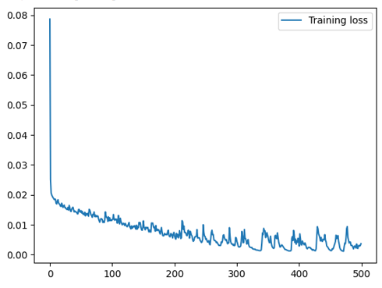
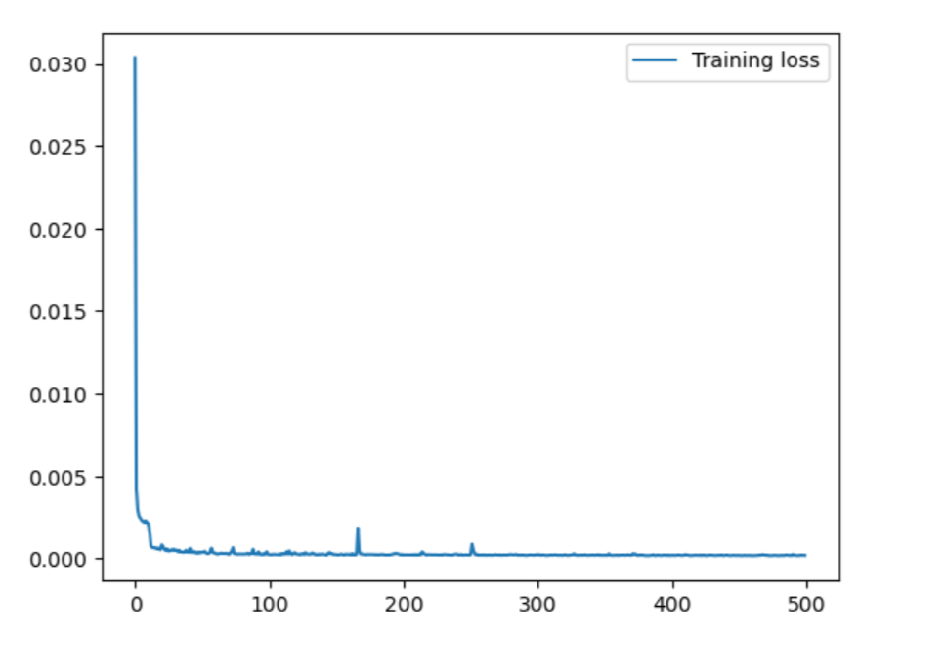
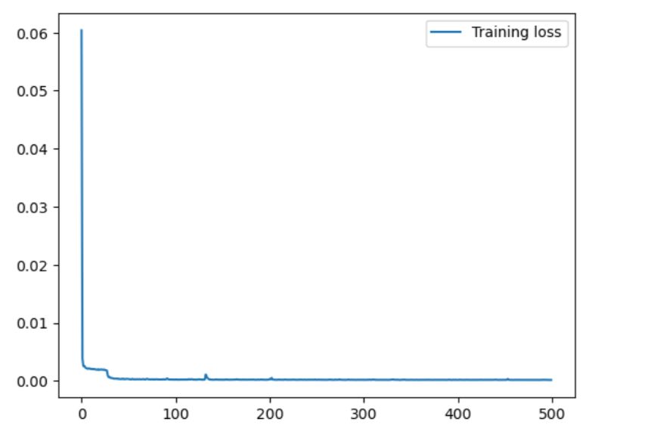
Training Loss vs Epochs
(a)
(b)
(c)
Fig 18: Training Loss vs Epochs
RNN Model
Training Loss: 5.07 x 10⁻⁴
Bi-LSTM Model
Training Loss: 1.842 x 10⁻⁴
GRU Model
Training Loss: 1.579 x 10⁻⁴
Pg. 30

Slide 33
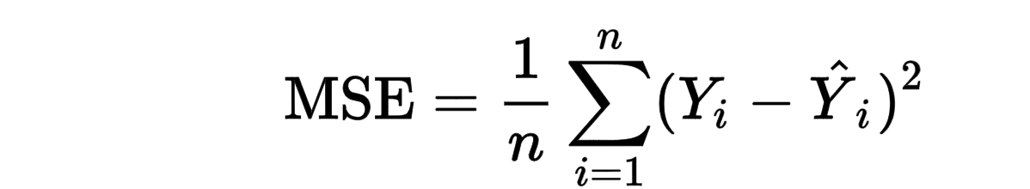
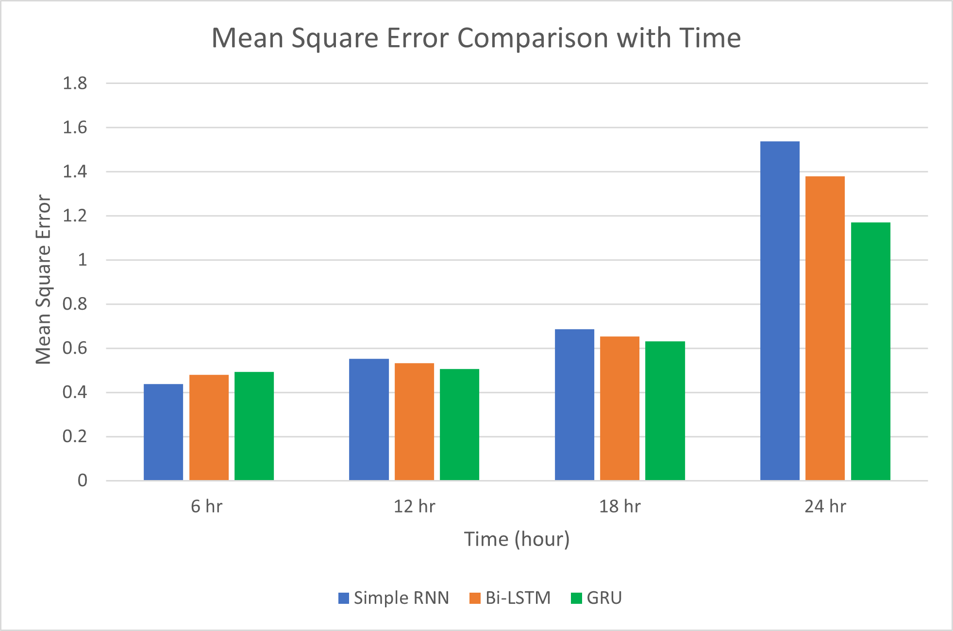
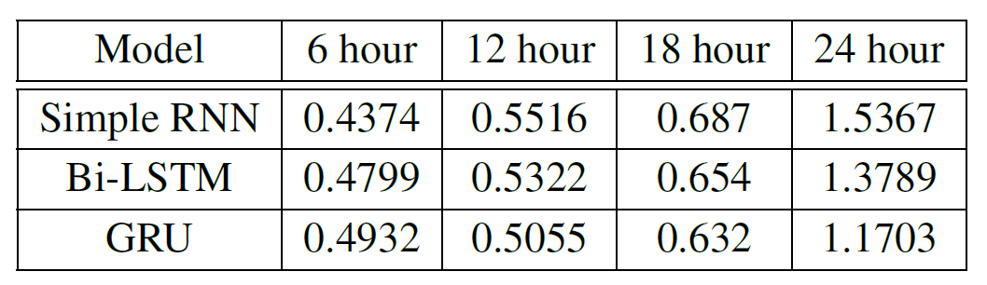
Mean Squared Error Loss
Equation 1: MSE
Table 7: Mean Squared Error
Fig 19: Mean Squared Error – Graphical Representation
Pg. 31

Slide 34
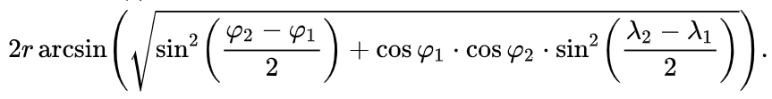
Distance-wise km Loss
Haversine Formula to calculate distance between two co-ordinates (in kilometre)
where
φ1 and φ2 are latitudes
λ1 and λ2 are the longitudes
Library used- geopy.distance
Mean of these values are calculated for future 6hr, 12hr, 18hr, 24hr and 36hr time
Equation 2: Haversine Formula
Pg. 32

Slide 35
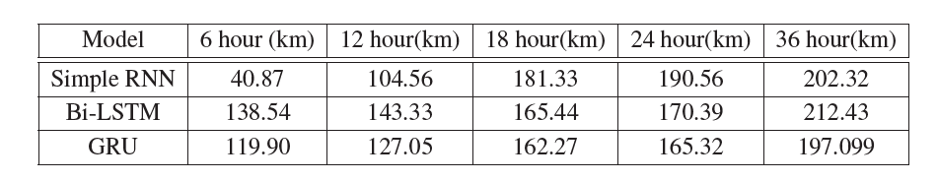
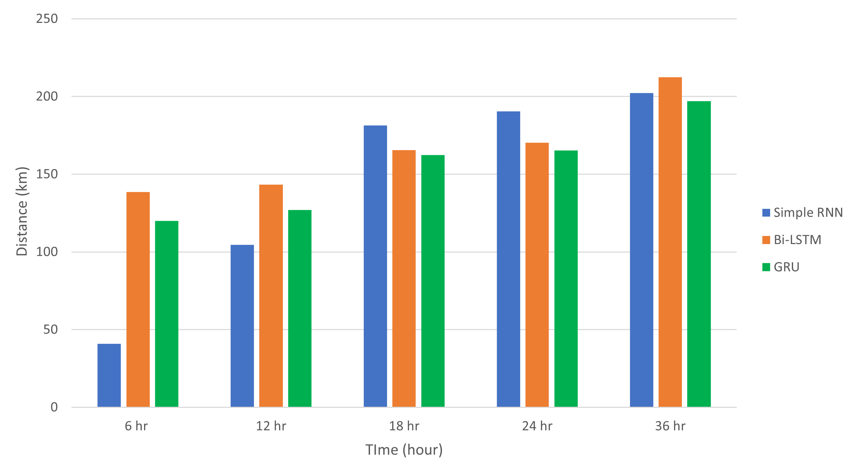
Distance-wise Model Comparison
Table 8: Distance wise model comparison error
Fig 20: Distance wise errors- Graphical Representation
Pg. 33

Slide 36
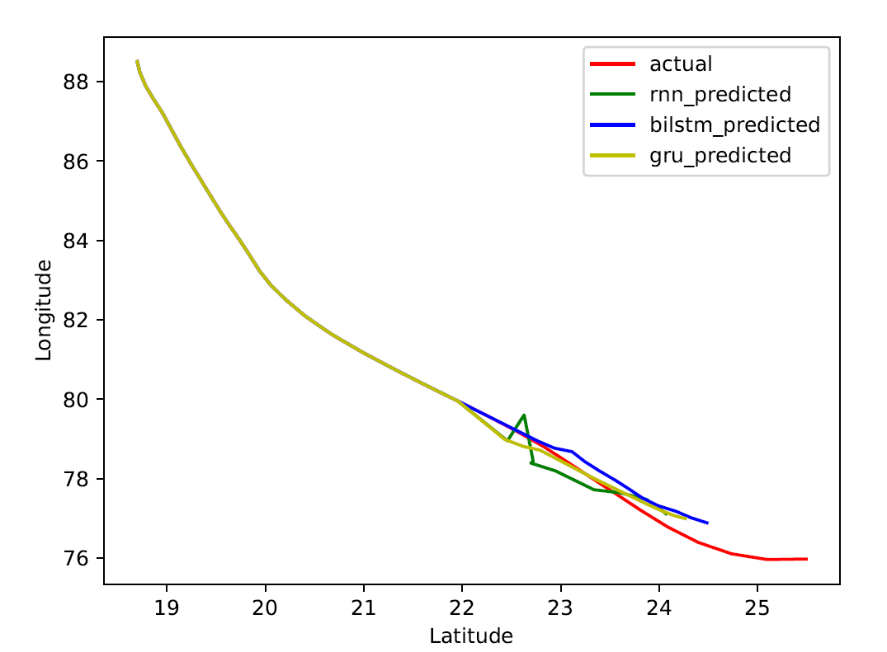
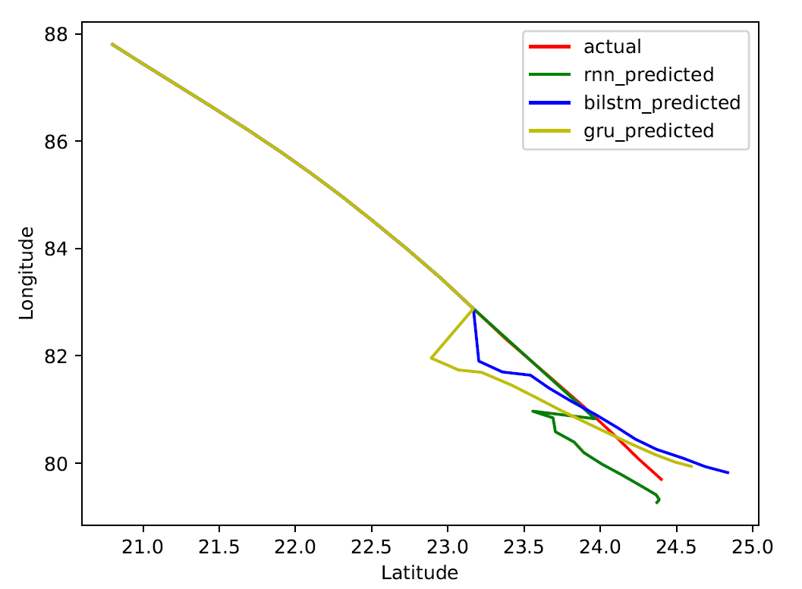
Model Comparison Graphs
Fig 21: Test result 1
Fig 22: Test result 2
Pg. 34

Slide 37
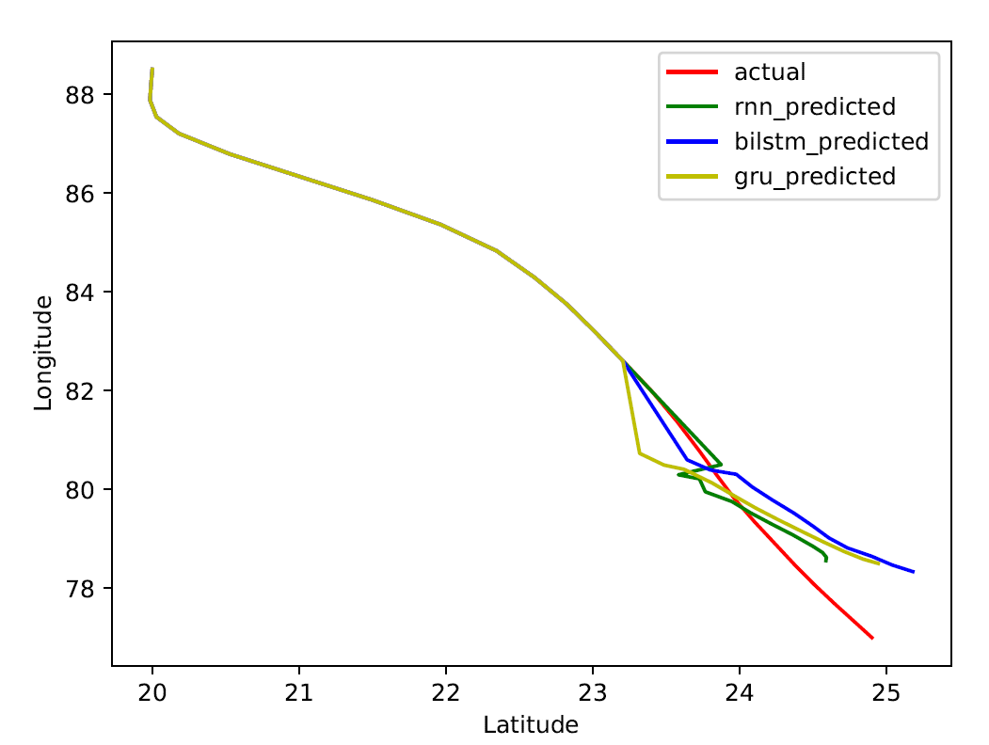
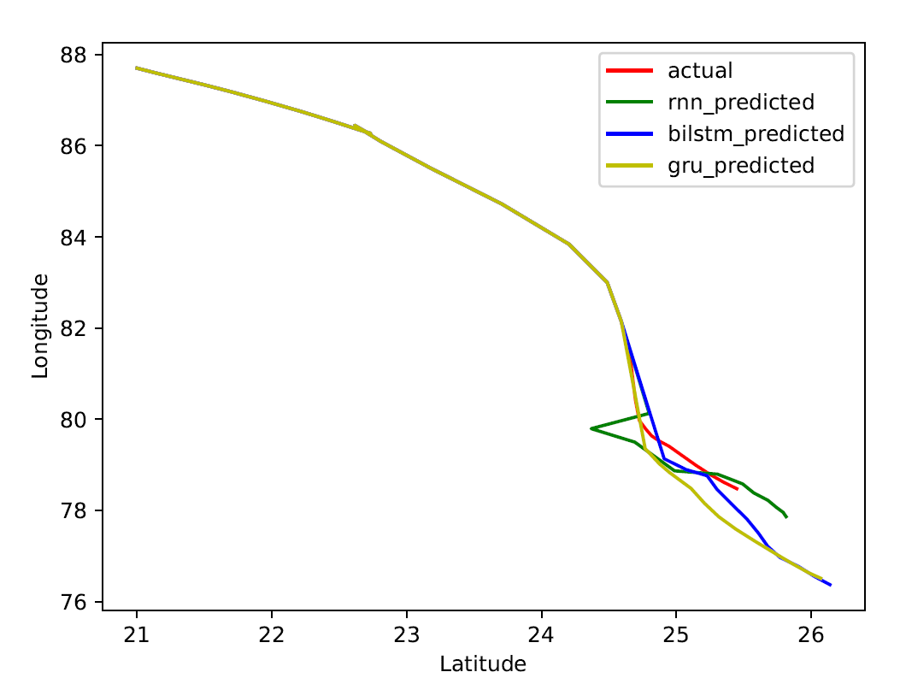
Model Comparison
Fig 23: Test result 3
Fig 24: Test result 4
Pg. 35

Slide 38
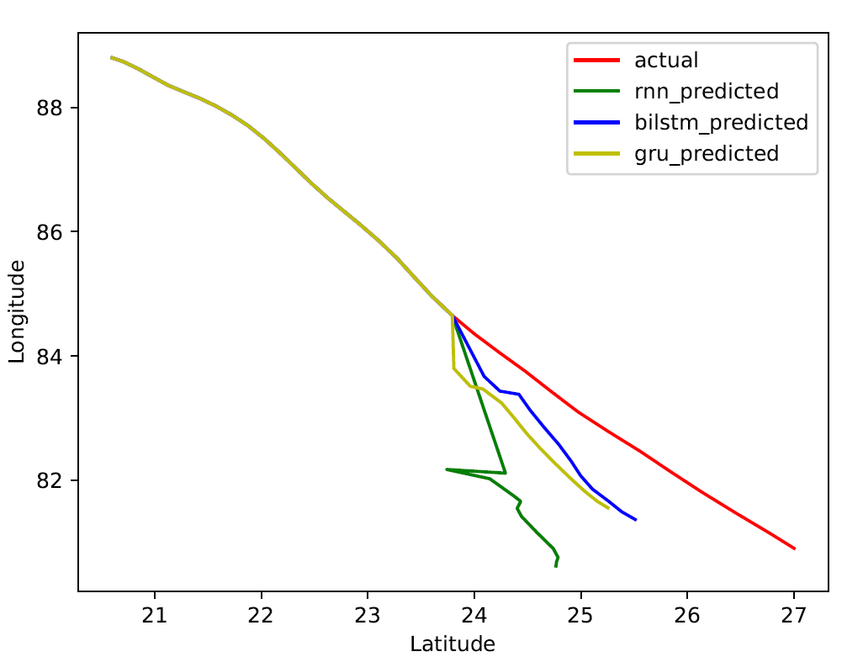
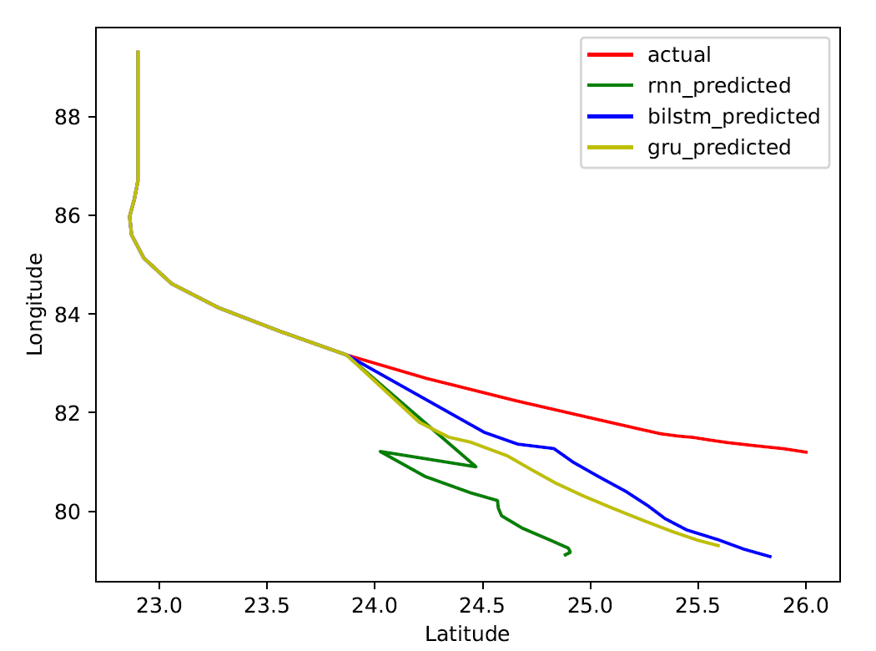
Model Comparison
Fig 25: Test result 5
Fig 26: Test result 6
Pg. 36

Slide 39
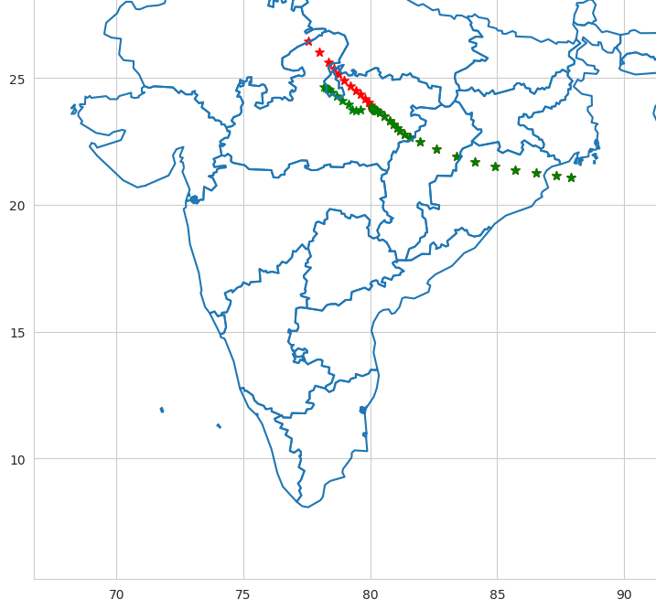
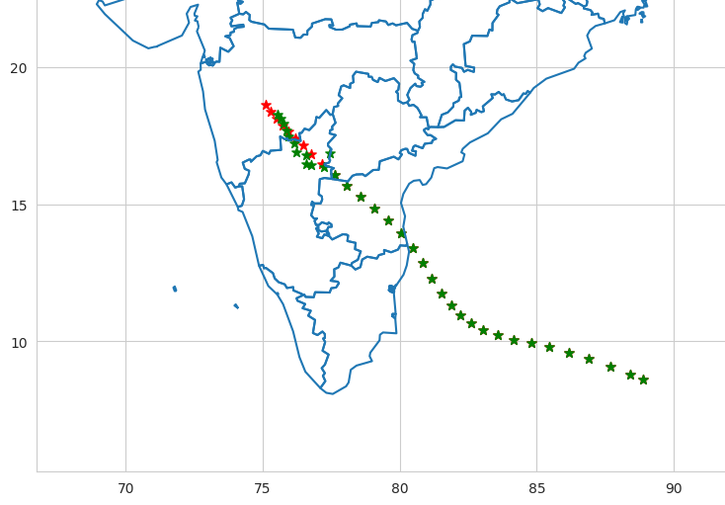
RNN Model – India Plot
Fig 27: RNN Test result I on Map
Fig 28: RNN Test result II on Map
Pg. 37

Slide 40
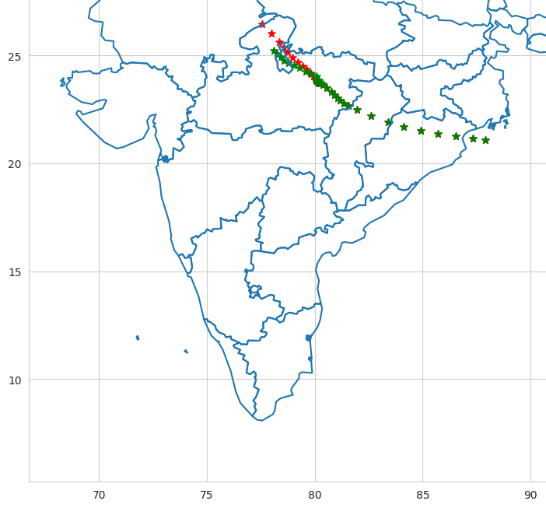
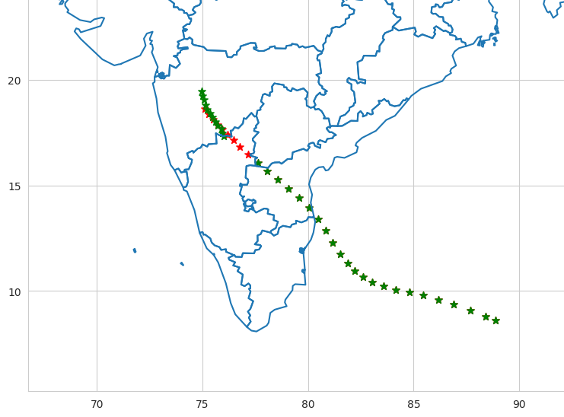
Bi-LSTM Model – India Plot
Fig 29: Bi-LSTM Test result I on Map
Fig 30: Bi-LSTM Test result II on Map
Pg. 38

Slide 41


GRU Model – India Plot
Fig 31: GRU Test result I on Map
Fig 32: GRU Test result II on Map
Pg. 39

Slide 42
Conclusion
YOLOv7 model for cyclone detection was discussed which was trained on 1608 and tested on 402 annotated images.
This model produced mAP of 0.742 and 0.68 on training and testing data with accuracy of 0.91 (training) and 0.85 (testing)
3 Deep Neural Network models – RNN, Bi-LSTM and GRU networks were used for path forecasting model
Mean square error, distance mean square error were calculated and plotted on India map for better interpretation of the regions affected
“RNN model was effective for short term (3hr & hr) prediction whereas GRU network model was having least error and showing better results for long term predictions (12-36 hr)”
Pg. 40

Slide 43
Future Work
Refining the cyclone detection model by increasing the dataset and the confidence level
Use of more advanced and latest frameworks of YOLO and their comparison for better accuracy and results
Architectural changes in the cyclone path prediction models and use of some more deep learning models for better and accurate results with least error
Pg. 41

Slide 44
Our Contribution
We have used YOLOv7 for Cyclone Detection Model instead of YOLOv3
We have used 4 features, Latitudes, Longitudes as well as Wind Speed and Wind direction to train our model
Comparison of three models RNN, Bi-LSTM and GRU with hyperparameter tuning and Distance wise results obtained.
Pg. 42

Slide 45
References
[1] Journal M. Haque, A. Adel, and K. Alam, “Deep learning techniques in cyclone detection
with cyclone eye localization based on satellite images,” 12 2021.
[2] Journal S. Shakya, S. Kumar, and M. Goswami, “Deep learning algorithm for satellite
imaging based cyclone detection,” IEEE Journal of Selected Topics in Applied
Earth Observations and Remote Sensing, vol. 13, pp. 827–839, 2020.Journal of Remote Sensing. Vol. 6, No. 1, 2018, pp. 1-5. doi: 10.11648/j.ajrs.20180601.11]
[3] F. Selim Furkan Tekin, “Forecasting of tropical cyclone trajectories with deep learning.” [Online]. Available: https://sftekin.github.io/pdfs/hurricane.pdf
[4] Y. Zhang, R. Chandra, and J. Gao, “Cyclone track prediction with matrix neural networks,” in 2018 International Joint Conference on Neural Networks (IJCNN), 2018, pp. 1–8
[5] https://github.com/WongKinYiu/yolov7
[6] https://learnopencv.com/yolov7-object-detection-paper-explanation-and-inference/
[7] https://www.kaggle.com/datasets/mikolajbabula/disaster-images-dataset-cnn-model
[8] “Recurrent neural networks cheatsheet.” [Online]. Available: https://stanford.edu/ ∼shervine/teaching/cs-230/cheatsheet-recurrent-neural-networks
[9] https://en.wikipedia.org/wiki/Long_short-term_memory
[10] “Gated recurrent unit.” [Online]. Available: https://en.wikipedia.org/wiki/ Gated recurrent unit
[11] S. Alemany, J. Beltran, A. Perez, and S. Ganzfried, “Predicting hurricane trajectories using a recurrent neural network,” 2018.
Pg. 43

Slide 46
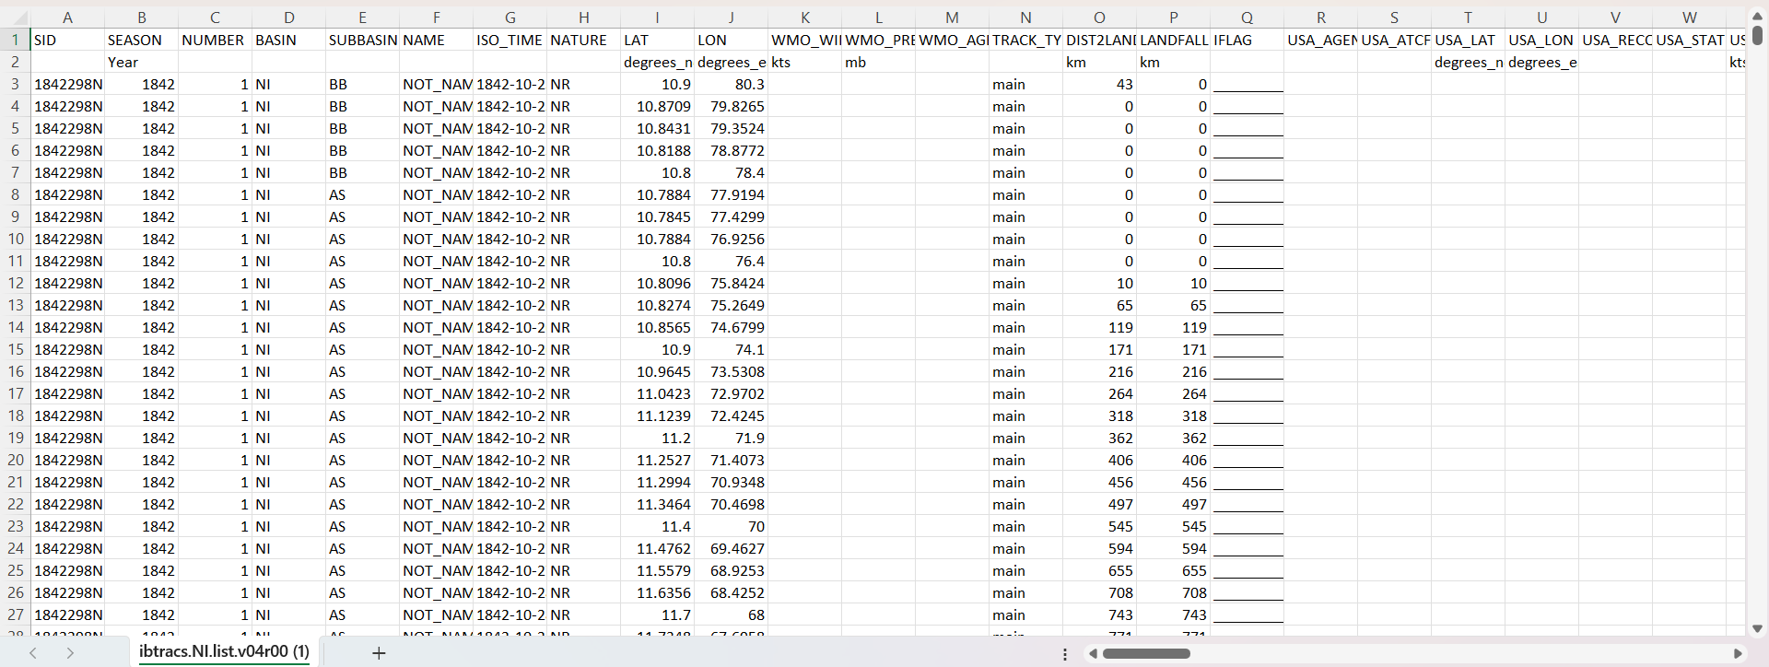
Appendix 1 - Dataset
Pg. 44

Slide 47
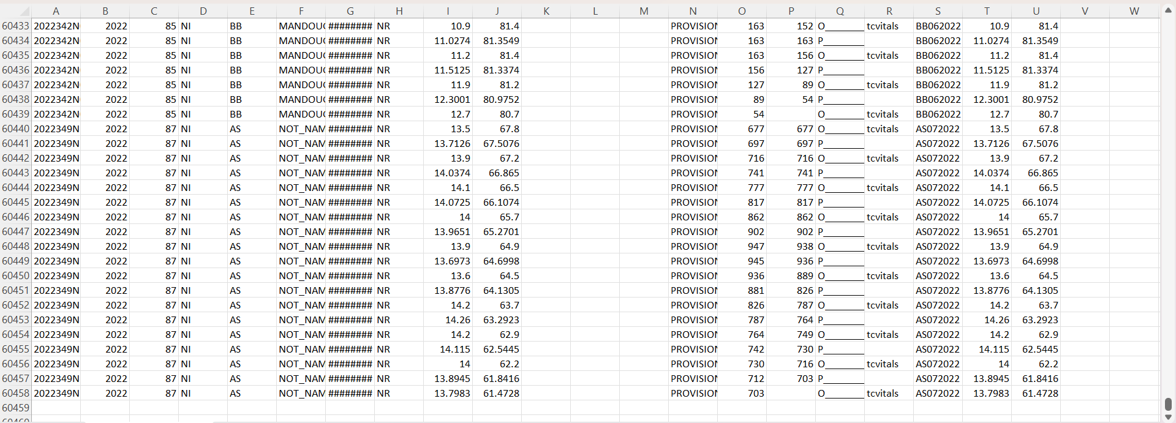
Appendix 1 - Dataset
Pg. 45

Slide 48
THANK YOU !

